Slide 1
Microservices and DevOps
Scalable Microservices
Test Double Services
Henrik Bærbak Christensen

Slide 2
Motivation
Integration testing again
… and service tests, and CDTs
The need for Meszaro’s test doubles
Easiest case
Use programmatic test doubles or mock libraries (in-process)
Requirement: Control of the dependency injection
You have to tell your service to use another implementation of a service interface
Program to an interface, use object composition, dep. injection

Slide 3
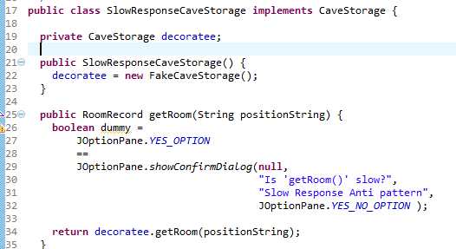
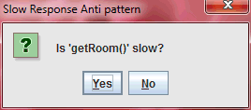
In Architectures
Meszaros (2007) has a special category of doubles
Saboteurs stubs that behave badly!
The ones we need for testing Nygard Stability Patterns.
Decorator pattern can be used, to add saboteur behavior

Slide 4
Motivation
But it is not always possible
Not programmed to an interface, no dependency injection
Low cohesion design
Service is accessed in 7.463 places all over the code…
Non “programmatic” interfaces (REST, UDP, …)
In a microservice/SOA context, services are remotely deployed services, and we need to test that as well
CDT and connector testing within a staging environment that is a real distributed system, but with saboteur doubles…
Can test latency issues, availability, etc.
Bad Architecture, IMO

Slide 5
Solution
Make test doubles that are deployed services
Support ‘out-of-process service tests’
That is
Conceptually identical
Difference: The interface
In-process service test doubles:
Java class implementing interface
Or Mock library generated class, with expectations set
Out-of-process service test doubles:
Deployed remote service on given port, programmed to respond to network calls, using ‘canned’ responses

Slide 6
How?
Well, of course you may just code it!
Make a (SparkJava) REST service that produce
canned responses
is slow responding
fail, drop network connection, send illegal JSON, send 1TB random byte array, return 1.000.000 item JSON array, …
Alternative: A programmable REST service…

Slide 7
Mountebank
A Nice Technology Choice

Slide 8

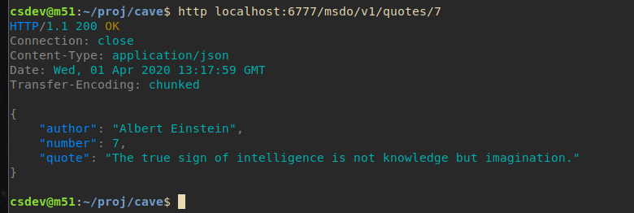
Demo
Goal:
Issue: The QuoteService returns random quotes
Test before we have developed this tricky service ☺
Goal: Make a deterministic test stub
Notes:
In my Reliable Software Architecture course, the quote service was (unlike our variant) responsible for the random quote, when given quote index 0.

Slide 9
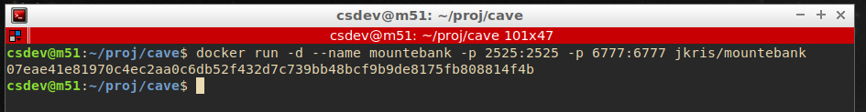
Installing? Nay
Mountebank is a NodeJS service ☹
Docker, help me…
2525 is Mountebank’s port
Must port map the imposter port as well
Using one of several mountebank images…

Slide 10
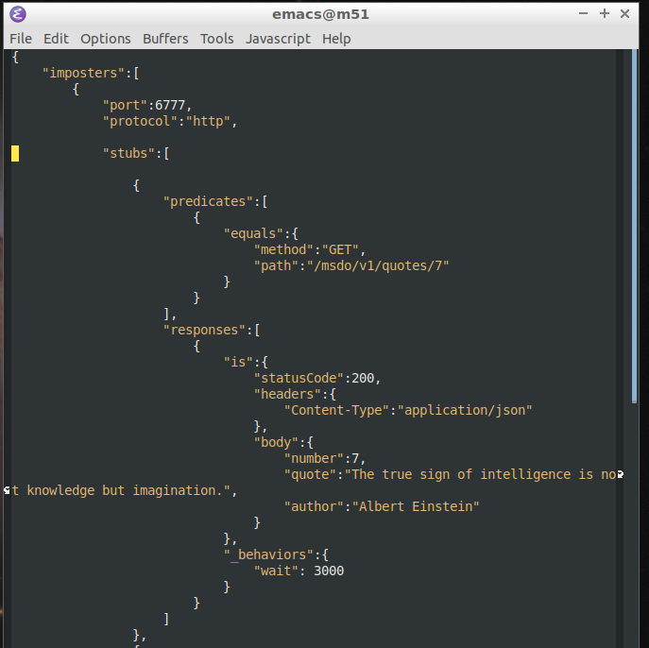
Define Behavior
Next we have to program the imposter…
Basically by POSTing a JSON configuration files to Mountebank
GET /msdo/v1/quotes/7
Response
Slow response!

Slide 11
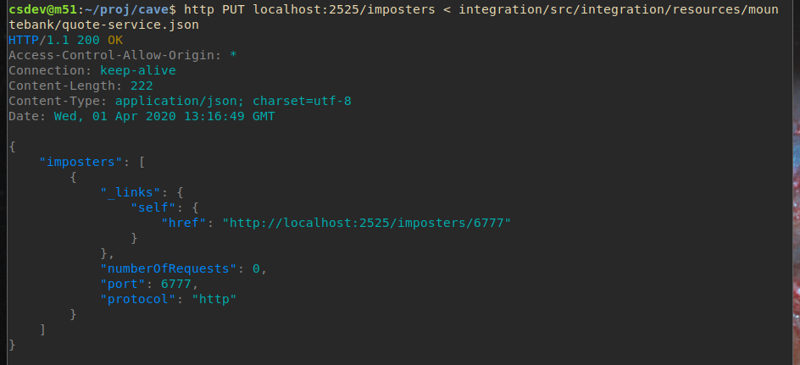
Step 2
Here I use ‘httpie’ to PUT the JSON to mountebank

Slide 12
Ok - Testing
Long wait here!
Now: A slow responding deterministic test stub service.

Slide 13

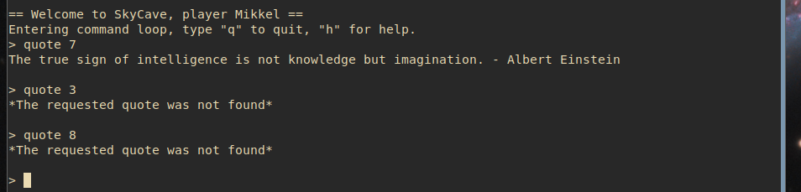
Testing

Slide 14
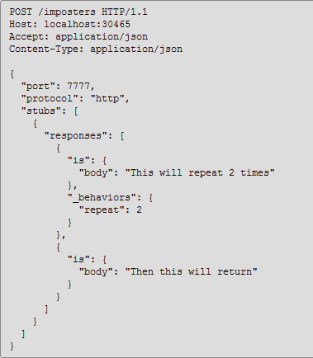
Advanced Features
Lots
Mock verifications
Variable behavior
Add more responses, taken in order
And on and on
Take care:
Doubles should be simple, or the bug will be in the double ☺
I spend quite some time debugging my JSON to find that ‘,’ I had misplaced ☹

Slide 15
TestContainers Context
I had a hell of a troubled time to get mountebank running in a TestContainers context ☹
Issue:
TC will await the port 6777 port opening for the doubled service
Which will not open until it programmed
Deadlock: waiting for an event that cannot happen ☹
Solution:
Do not use PUT/POST for programming, instead volume mount a ‘config.json’ file with the double behavior specification, and tell mountebank to read that.

Slide 16
Conclusion
We can replace programmatic test doubles with service test doubles when
The UUT has no well encapsulated API to the service and/or no dependency injection in place
We want to make integration testing in a real distributed staging environment
Mountebank is a really nice and flexible tool
Use it in the mandatory on safe failure modes…

